Slide 1
Counterpoint Generator
By Caleb Nelson and Elliott Claus

Slide 2
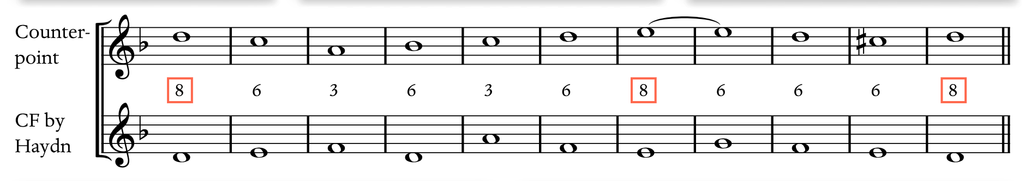
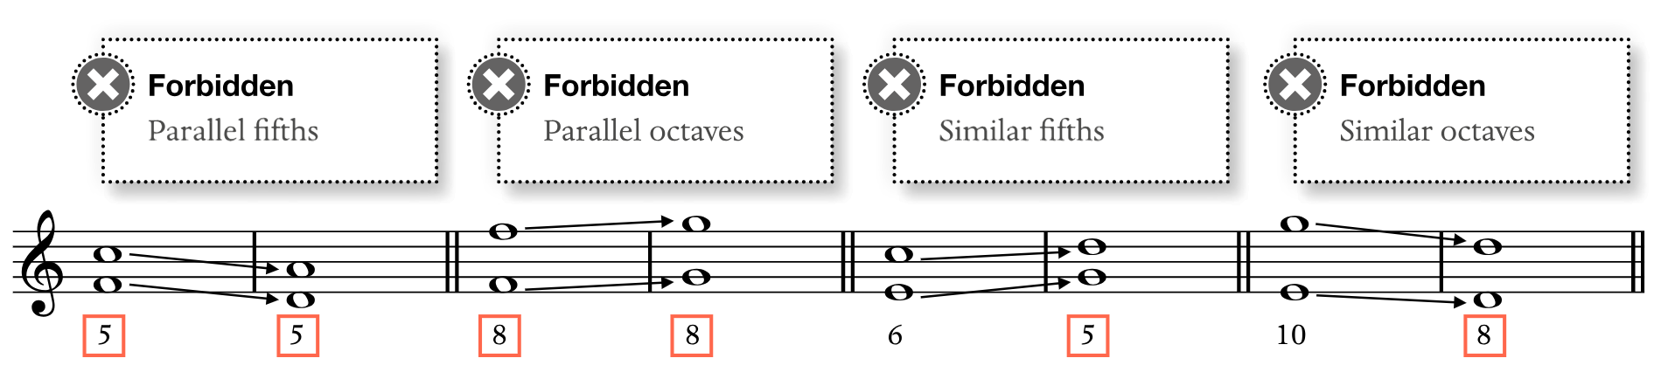
Problem Definition

Slide 3
Requirements and Challenges
Writing music
Saving notes
Using logic to check for errors
Deciding which part of the program does what
Translating music theory into code
Exporting music
Understanding basic music rules
Integrating with LilyPond
Exporting different lengths
Exporting different keys
Exporting different time signatures

Slide 4
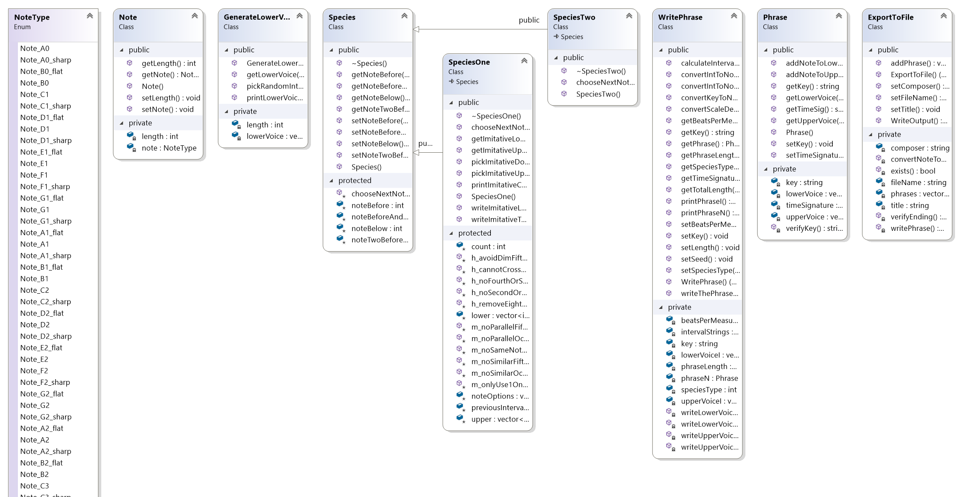
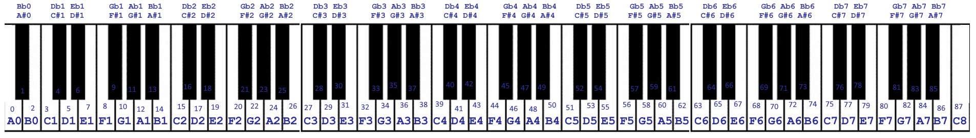
Class Hierarchy Diagram

Slide 5
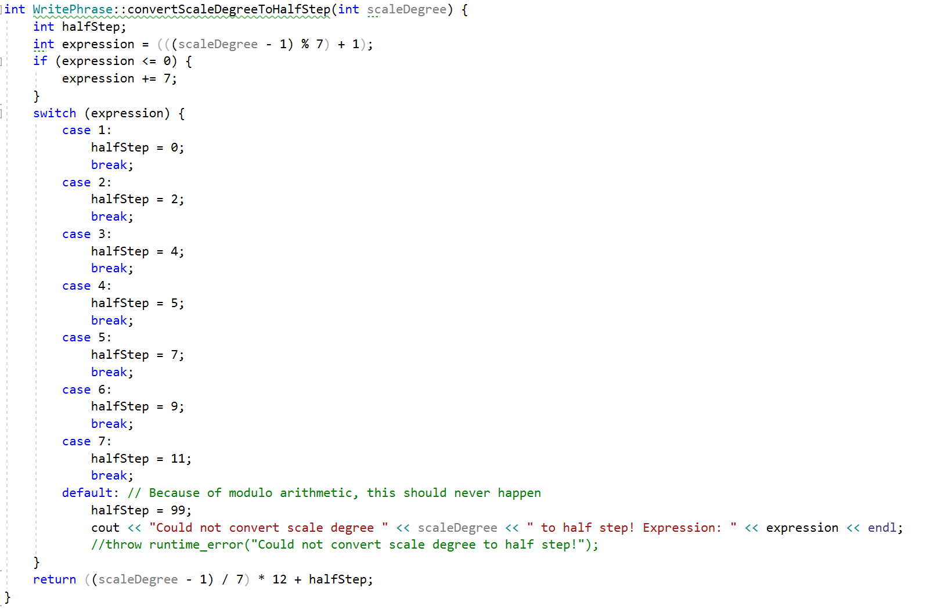
Distinctive Aspects

Slide 6
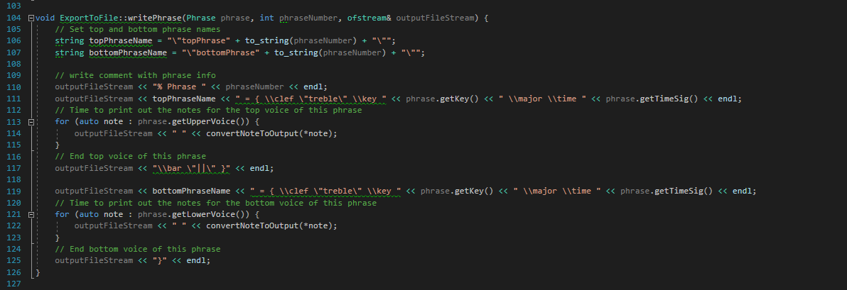
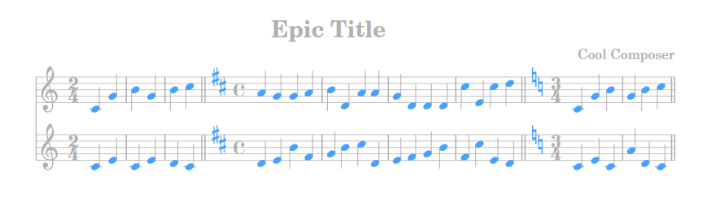
Distinctive Aspects Continued

Slide 7
Citations
Burstein, L. Poundie., and Joseph Nathan. Straus. Concise Introduction to Tonal Harmony. W.W. Norton, 2016.

